Slide 1
Comp Grid Automation
User Manual
Edward Bergman
Stella-Leonie Wancke
Jiajian(Drew) Chen
August 9, 2022

Slide 2
Agenda
Introduction
Prepare input files
Initialization in Python
Application
Common errors and solutions
To develop

Slide 3
Introduction
What, Why, How, When, Who
Notes:
Additional section numbers (1-9) can be found in the slide master. Select “Home” then “Layout” then select the slide template you would like.

Slide 4
Introduction
What is it:
A Python script to automate the generation of Comp Grid
Who are users:
The pricing project managers
When to use:
After finalizing PPG definition, before uploading Comp Grid to AMP
Why do we create it:
Efficiency: Manually generating comp grid takes multiple hours, or even days
Consistency: “Your Brain Isn’t Wired for Consistency” - Noa Kageyama, Ph.D.
How does it work:
The machine generates Comp Grid based on defined PPGs list and interaction rules
PPGs list
Comp Grid Automation
Comp Grid (AMP input)
Interaction Rules
(IRE/Score)
Comp Matrix
Source: Italicized Text (6 point)

Slide 5
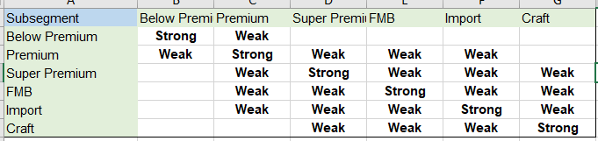
Interaction Methods
What is IRE and Score?
Ignore, Regular, Expected (IRE)
The regular, most common method to evaluate the interaction type between PPGs
Explanation:
If there is any (Blank) interaction across attributes between two PPGs, their interaction is Ignore (0)
If there is no (Blank) and at least one Weak interaction across attributes between two PPGs, their interaction is Regular (1)
If there are all STRONG interactions across attributes between two PPGs, their interaction is Expected (2)
PPG’s interaction with itself is showed as “X”
Score
A highly flexible method based on addition of numbers pre-assigned in interaction rule matrices

Slide 6
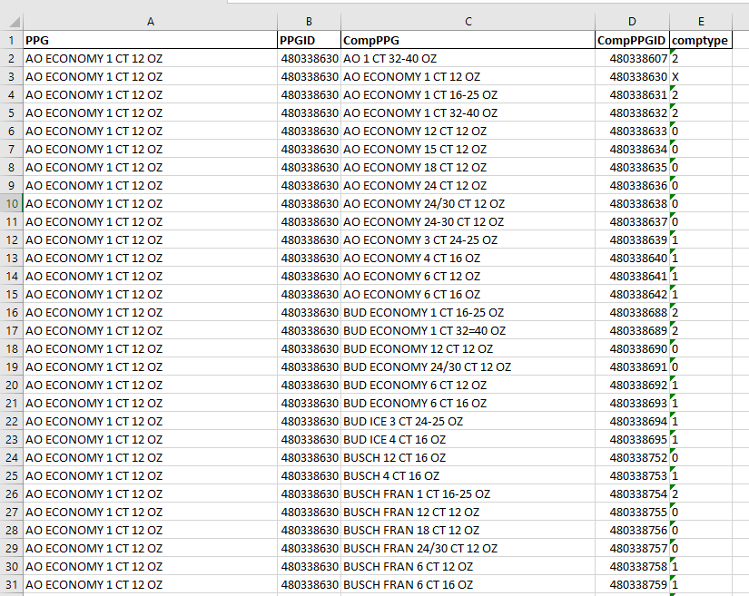
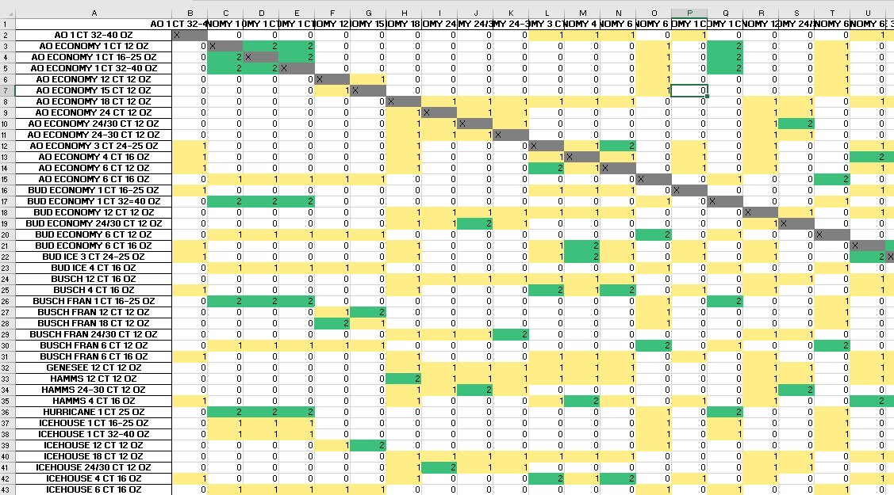
What are the outputs
Comp Grid (AMP input)
Comp Matrix

Slide 7
Prepare input files
Required: PPGs_Attributes.xlsx
Interaction_Rules.xlsx
Optional:
AMP_RGM_ClientName_CUSTOME_PPG_List.csv

Slide 8
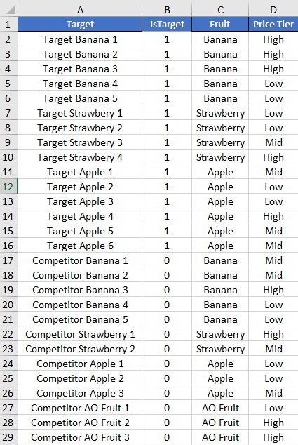
PPGs_Attributes.xlsx
The file including PPG names, recognizer and attributes
The first two columns must be <PPG Name> and <IsTarget>
Column <IsTarget> is binary:
target PPGs = 1, competitor PPGs = 0
The rest columns must be attributes
No limit on the number of attributes

Slide 9
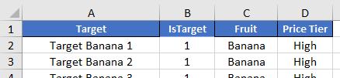

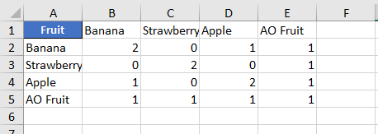
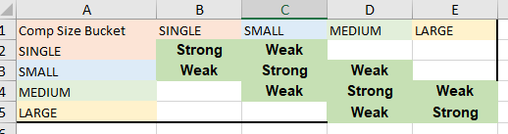
Interaction_Rules.xlsx
Score method
The file including attribute interaction matrices
The tab names must be exactly the attribute names in PPGs_Attributes.xlsx
The A1 cell value must be exactly the same as the tab name
Both Col A and Row 1 must be a complete list of attribute levels
For <Score> method:
Values in the matrix must be numeric (no blank)
For <IRE> method:
Values must be Strong / Weak / (blank)
Attribute Cols
Tab Names
A1 Value
IRE method

Slide 10
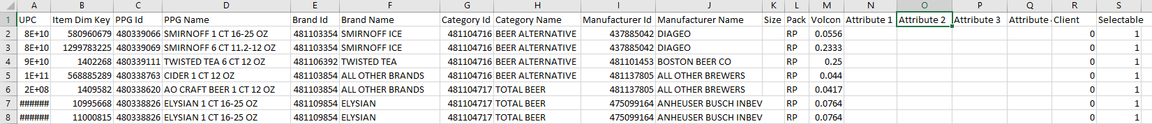
AMP_RGM_ClientName_CUSTOME_PPG_List.csv
The file downloaded from AMP
This file is for automating mapping the PPG Id and PPG Name in the final output so that it’s ready to upload to AMP

Slide 11
Application

Slide 12
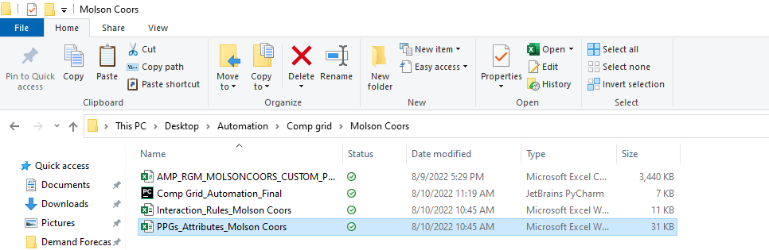
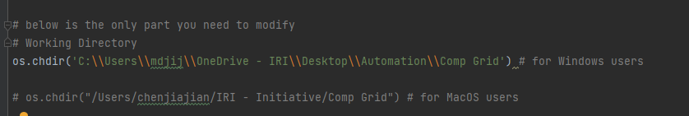
Initialization in Python
Open the working folder -> Copy path -> Paste at the os.chdir() line in code -> Run

Slide 13
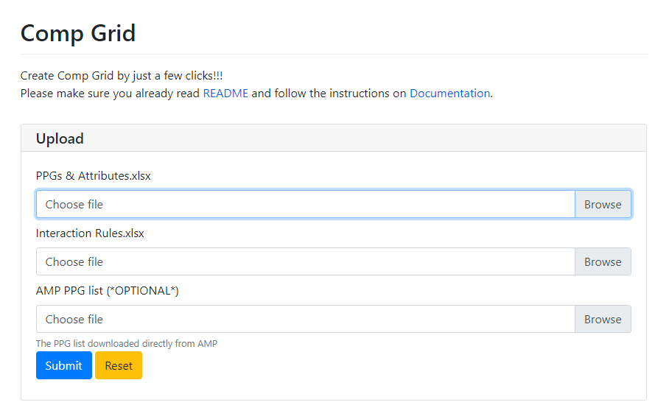
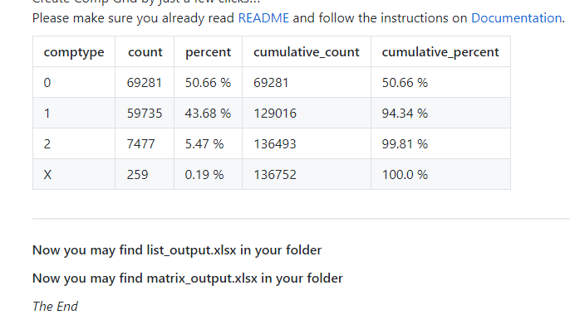
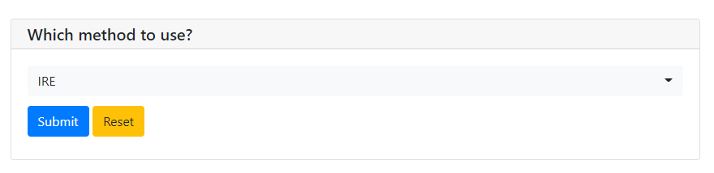
In the App
Just click as guided
1. Summary Table
2. Comp Grid (AMP input)
3. Comp Matrix

Slide 14
Common errors and solutions

Slide 15
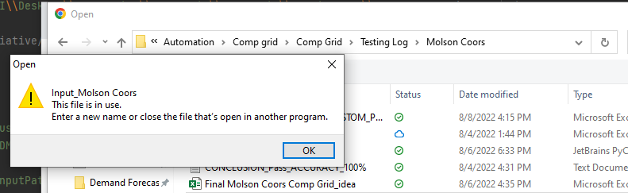
PermissionError: [Errno 13] Permission denied: 'C:\\Users\\****\\Desktop\\File1'
Solution: close input files before running

Slide 16
QUESTIONS & NEXT STEPS

Slide 17
REPLACE WITH CLIENT
LOGO
Notes:
Co-branded closing slide example

